Slide 1
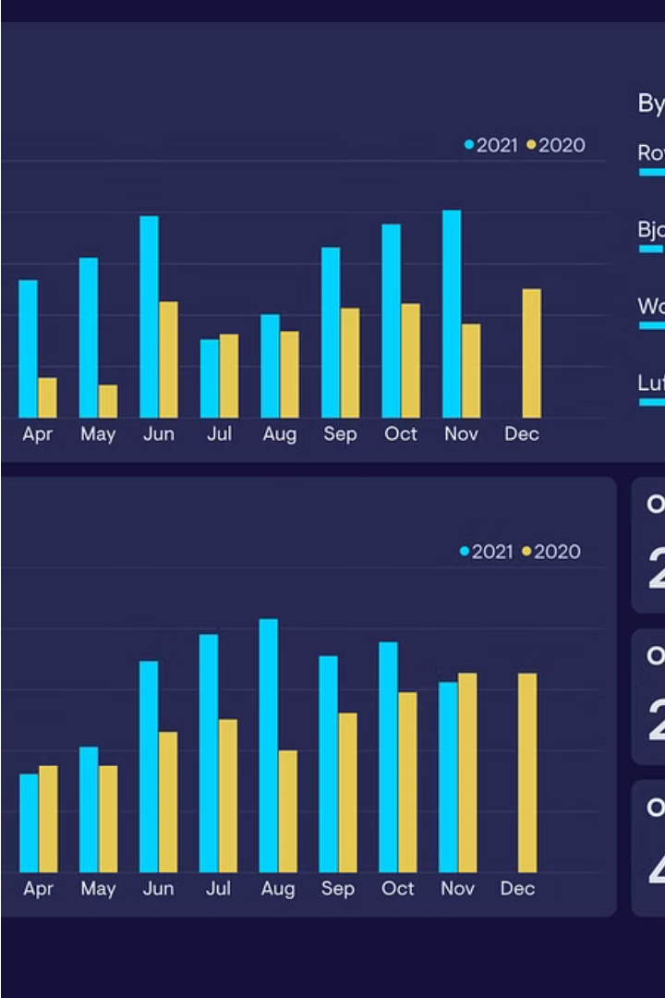

Performance Excel Dashboard
BY SANSKAR GUPTA

Slide 2


DESCRIPTION OF PERFORMANCE DASHBOARD
I designed and maintained a sales performance dashboard that provide real time insight .some key features are
1
REVENUE TRENDS
Presented revenue trends over time allowing team leader to identify seasoned patterns and
Adjust strategies accordingly
2
TOP PERFORMERS
Highlighted top-performing sales reps based on metrics such as deal size, win rate
, and outreach efforts.
.
3
QUOTA ATTAINMENT
Monitored team progress toward monthly sales targets, highlighting areas where performance exceeded or fell short of expectations.

Slide 3
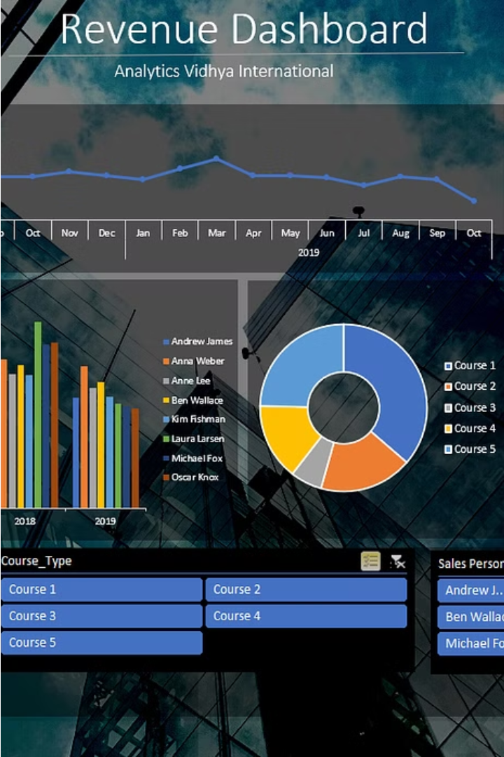
REVENUE TRENDS

Slide 4
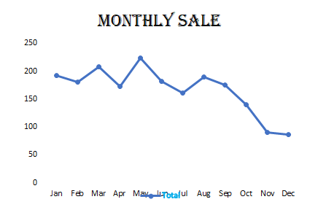
QUOTA ATTAINMENT

Slide 5
TOP PERFORMERS

Slide 6
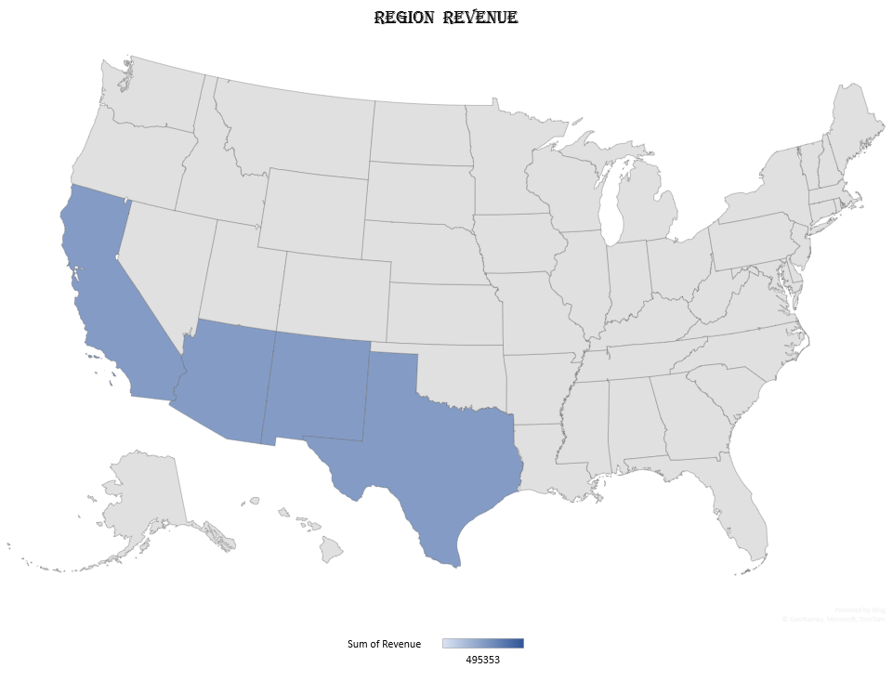
REGION REVENUE

Slide 7
